Slide 1
Breathing & Respiration
https://teachmephysiology.com/respiratory-system/ventilation/mechanics-of-breathing/#:~:text=During%20breathing%2C%20the%20contraction%20and%20relaxation%20of%20muscles,in%20turn%20changing%20the%20pressure%20inside%20the%20lungs.
Wendy Chai

Slide 2
Breathing V.S. Respiration
Breathing
Muscular movements which keep the respiratory surface supplied with oxygen.
Q: Across where/ which structure do O₂ diffuse into blood?
In humans, breathing or pulmonary ventilation is the movement of air into and out of the lungs.
(cellular) Respiration
A series of chemical reactions which happens in all living cells, in which food is broken down to release energy, usually by combining it with oxygen.

Slide 3
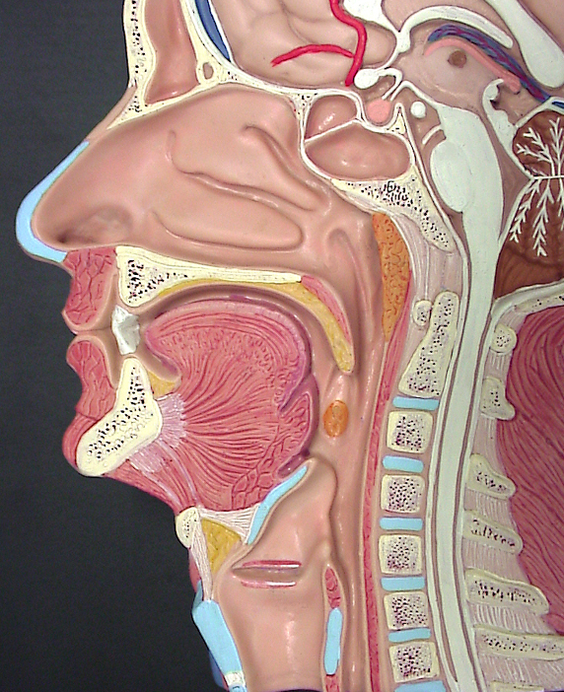
Identify:
Nose, nasal cavity
Mouth, tongue, teeth
Esophagus
Epiglottis
Vocal cords
(Trachea)
esophagus
Larynx: also called vocal box, contains vocal cords, sit on top of trachea.
Function?
Notes:
Larynx is situated just below where the tract of the pharynx splits into the trachea and the esophagus.It is an organ in the top of the neck involved in breathing, producing sound and protecting the trachea against food aspiration.

Slide 4
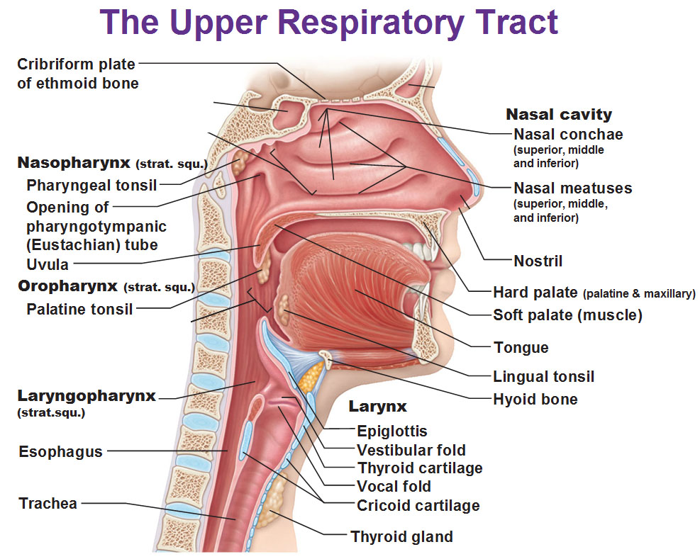
Notes:
The pharynx (fayr’-inks), commonly called the throat, is a short passageway that lies posterior to the nasal and oral cavities and extends inferiorly to the larynx and esophagus. It has a muscular wall and it is lined with mucosae containing stratified squamous epithelium. As shown in, the pharynx consists of three parts: the nasopharynx posterior to the nose; the oropharynx posterior to the mouth; and the laryngopharynx posterior to the larynx.

Slide 5
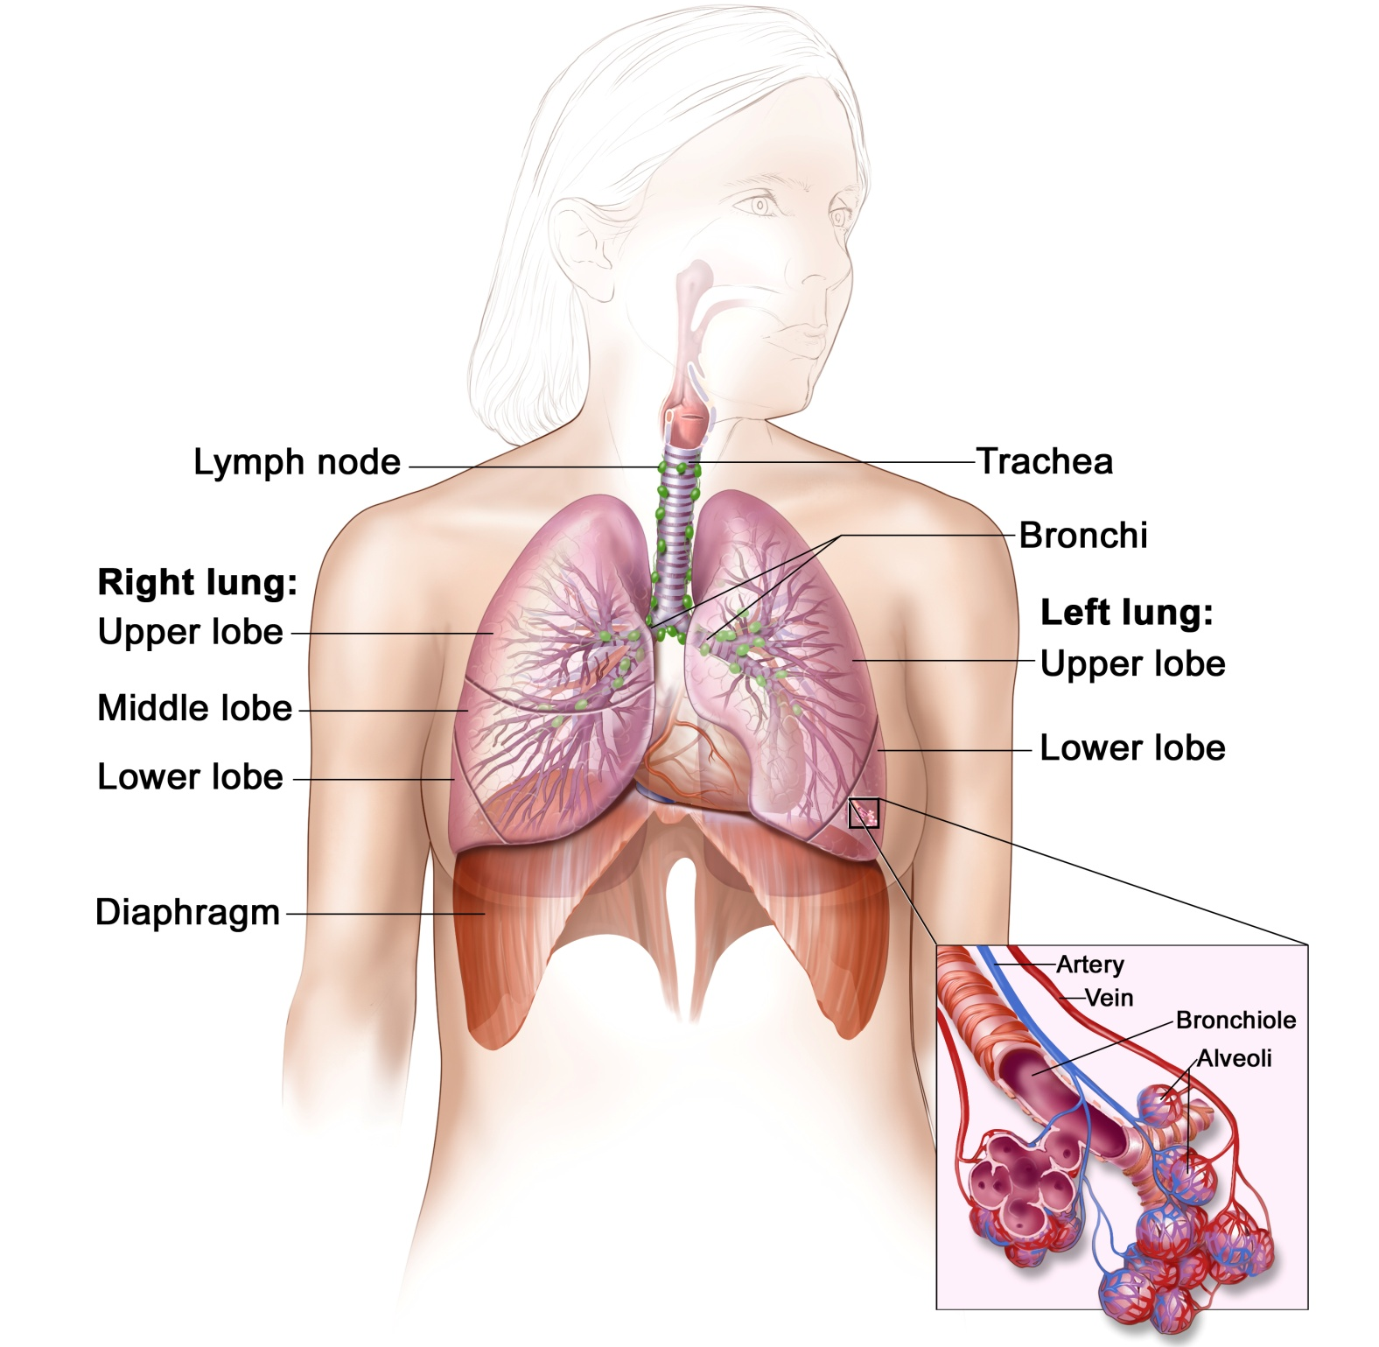
Respiratory system/ Breathing system
Trachea
Bronchus/ bronchi
Bronchioles
alveoli

Slide 6
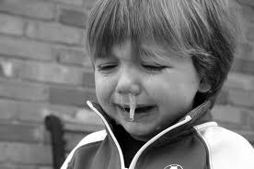
Nose
Warms, moistens and cleans the air we breathe in.
It produces mucus that protects the lungs from bacteria and harmful substances when we breathe in.

Slide 7
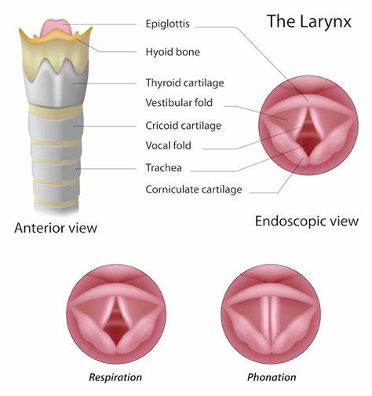
Throat
Air enters the windpipe (trachea) through a small hole, the glottis.
The epiglottis is a small, flap that closes over the glottis when we swallow to prevent food from going down the trachea.
The throat contains the voice box (larynx) with the vocal cords that produce sounds.

Slide 8
Trachea
The walls of the trachea are stiffened with cartilage to keep it open all the time (cartilages support trachea).
The inner lining of the trachea (as well as the nose and bronchi) contains goblet cells that produce mucus, and other cells that are covered with cilia.
Q: Why is there C-shaped cartilage in walls of trachea?
Hint: resilient, has rigidity, not as hard and rigid as bone

Slide 9
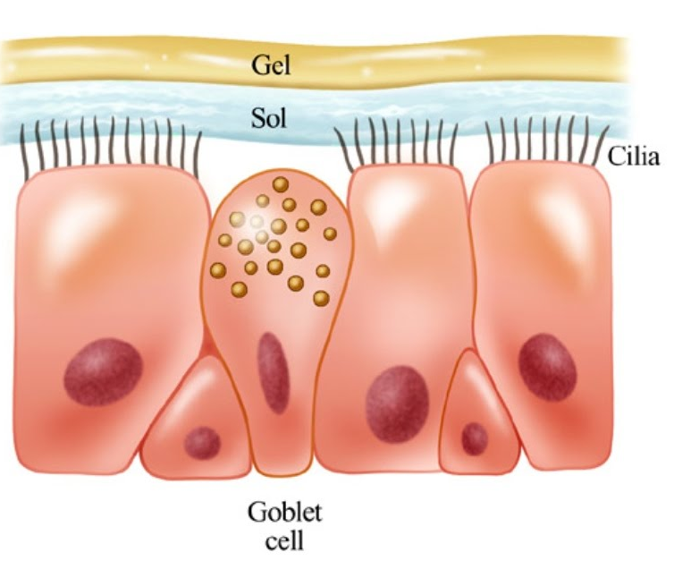
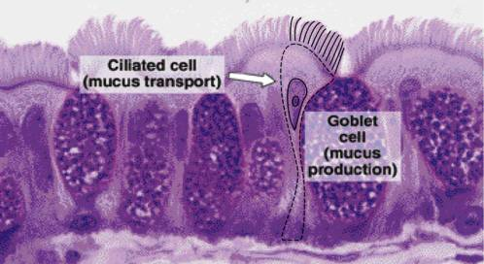
Trachea
The cilia move mucus containing any trapped dust particles or bacteria upwards towards the glottis where it is swallowed.
This helps to prevent bacteria and harmful substances getting into the lungs.

Slide 10
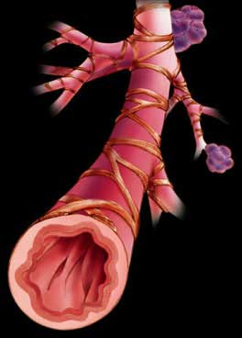
Bronchus/ bronchi
After the trachea has entered the chest, it splits into two short tubes called the bronchi - one to each lung.
The bronchi are similar to the trachea, but narrower.
Inside the lung the bronchus splits into many branches - called bronchioles - that get very narrow towards the ends.
The walls are not surrounded by cartilage; instead, they contain smooth muscle that lets them become wider or narrower.

Slide 11
Alveoli
Each bronchiole leads to a bunch of tiny sacs called alveoli.
These are surrounded by a network of blood capillaries. The capillaries are in close contact with the alveoli and the membrane separating them is very thin.
This is where gas exchange takes place.
The alveoli provide a very large surface area so that more oxygen can be taken up by the blood system every time we breathe.
More carbon dioxide can be removed and breathed out.

Slide 12
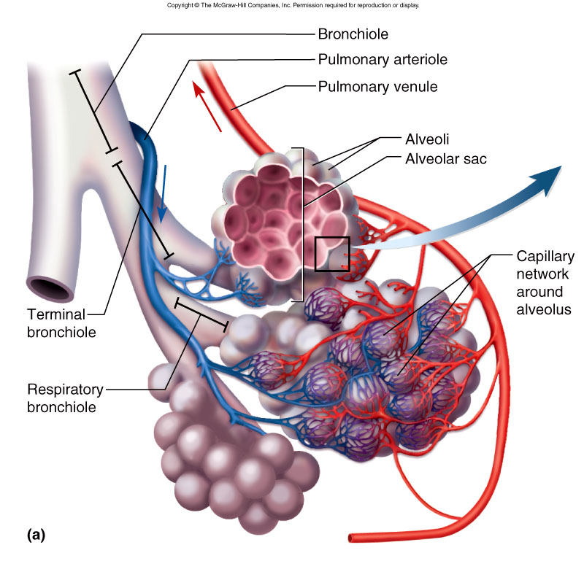
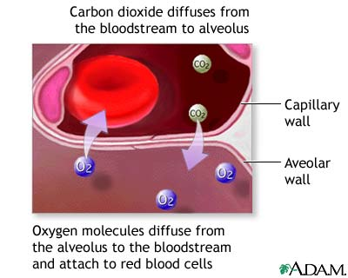
Alveoli
Oxygen diffuses from the alveoli into the blood
Carbon dioxide diffuses from the blood into the alveoli.
The lining of each alveolus is covered by a thin layer of fluid and the oxygen dissolves in this before it passes through into the blood.

Slide 13
Gas exchange surfaces
In humans ( and most other animals), gas exchange surfaces have the following properties:
A large surface area
A thin surface layer
A good blood supply and
A good supply of O₂/ Good ventilation with air.

Slide 14
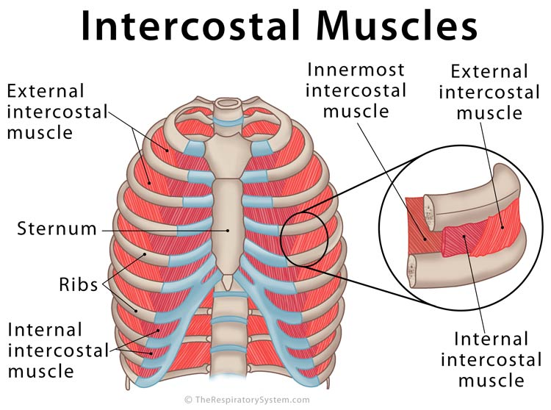
Breathing (Ventilation)
1 Rib cage
2 Intercostal muscles located between each of the twelve sets of ribs:
External intercostal muscle
Internal intercostal muscle
3 Diaphragm

Slide 15
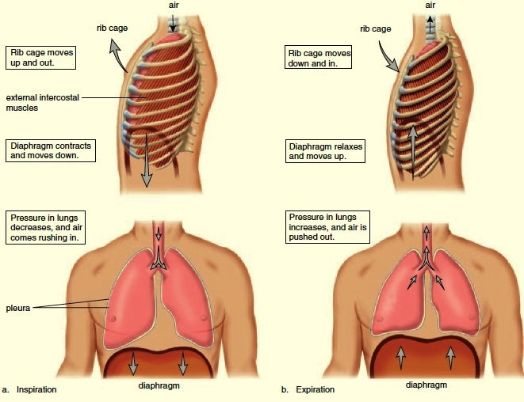
Breathing in – Inspiration/ Inhalation
Ribs move up and out
Chest volume increase
Diaphragm contracts and move down
Pressure decrease
Air rush in

Slide 16
Breathing in – Inspiration/ Inhalation
1) The external intercostal muscles contract (and internal intercostal muscles relax).
2) The ribs move upwards and outwards.
The diaphragm muscles contract and flattens.
The diaphragm flattens out.
These factors result in a larger chest volume with a lower pressure, so air is forced into the lungs (down the pressure gradient).
The external intercostal muscles are responsible for forced and quiet inhalation. They raise the ribs and expand the chest cavity.
The internal intercostal muscles are responsible for forced exhalation. They depress the ribs and decrease space in the chest cavity.

Slide 17
Breathing out – Expiration/ exhalation

Slide 18
Breathing out – Expiration/ exhalation
1) The external intercostal muscles relax (and internal intercostal muscles contract if needed in forced expiration).
2) The ribs move downwards and inwards.
The diaphragm muscles relax and return to its resting position (dome shape).
The diaphragm returns to its usual dome shape.
The volume inside the chest cavity gets smaller with a higher pressure, so air is forced out of the lungs.

Slide 19
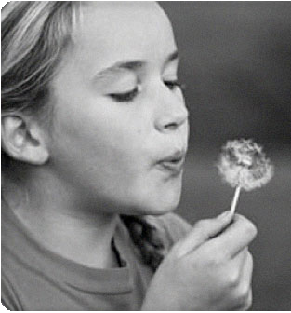
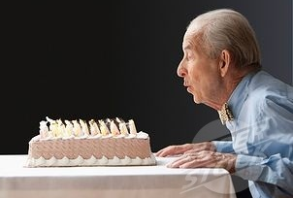
Internal intercostal muscles (used in forced breathing)
The internal intercostal muscles (and innermost intercostal) sometimes contract and force out more air than normal (depress ribs). For example, during:
exercise
Coughing
Blowing

Slide 20
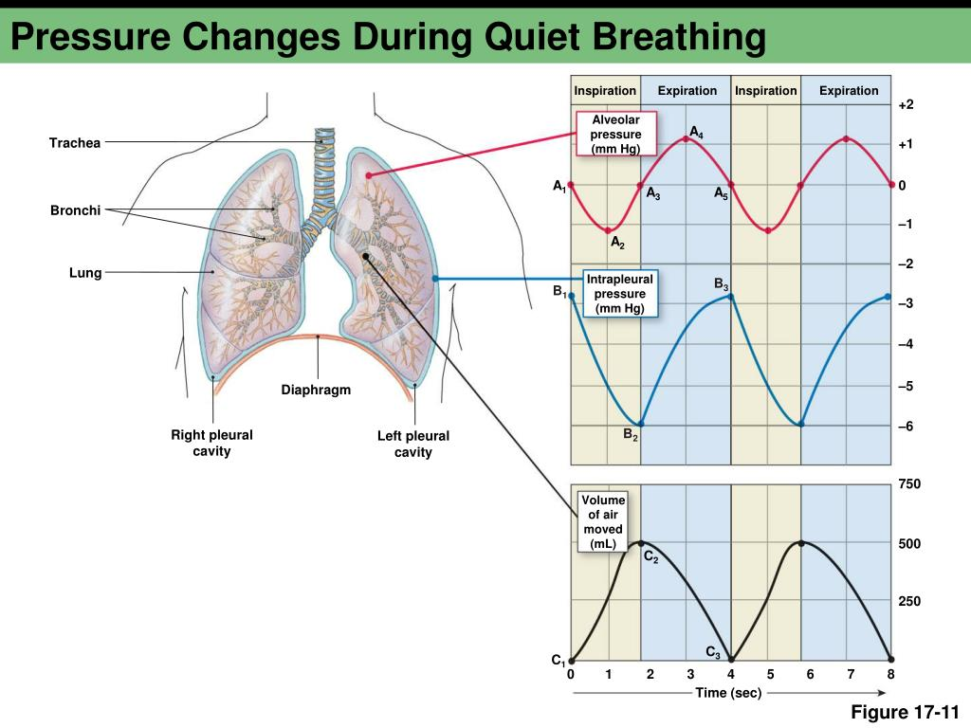

Slide 21
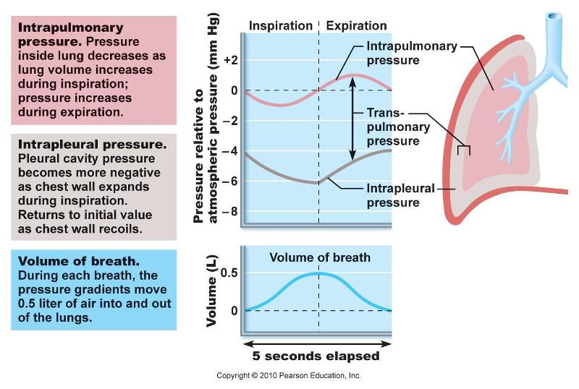

Slide 22
Composition of Inspired and Expired air
Gas | Inspired air | Expired air
Oxygen | 21% (High) | 16% (Low)
Carbon dioxide | 0.04% (Low) | 4% (High)
Water vapour | variable | high

Slide 23
Effects of Physical Activity
Rate of breathing.
During exercise muscles work harder, so need more oxygen.
More carbon dioxide is produced which needs to be removed.
Q: How does the brain know the body need to breathe faster and deeper?
A: The brain senses there is too much CO₂ in the blood (low pH) and this automatically causes us to breathe faster.

Slide 24
Effects of Physical Activity
Depth of breathing.
Fit people tend to breathe more deeply when they exercise, taking in more air each time they breathe.
Unfit people tend to breathe more quickly, keeping their breathing more shallow.

Slide 25
Respiration
Respiration is the chemical reactions that break down nutrient molecules in living cells to release energy.
Respiration involves the action of enzymes in cells.
Energy is used for many processes in the human body including:
muscle contraction
protein synthesis
cell division
active transport
growth
transmission of nerve impulses
the maintenance of a constant body temperature

Slide 26
Respiration
There are two main types of respiration:
Aerobic respiration – the chemical reactions in cells that use oxygen to break down nutrient molecules to release energy
Anaerobic respiration – the chemical reactions in cells that break down nutrient molecules to release energy without using oxygen.

Slide 27
Aerobic Respiration
This is the release of a relatively large amount of energy in cells by the breakdown of food substances in the presence of oxygen.
Takes place in most living organisms.
Word equation:
Glucose + Oxygen → Carbon Dioxide + Water (+ Energy)
Balanced equation:
C₆H₁₂O₆ + 6O₂ → 6CO₂ + 6H₂O (+ 36ATP)
Notes:
36 ATP released from per glucose molecule

Slide 28
Anaerobic Respiration
This is the release of a relatively small amount of energy by the breakdown of food substances in the absence of oxygen.
There are two types of anaerobic respiration which produce ethanol and lactic acid respectively
This anaerobic process is also called fermentation, an anaerobic pathway for breaking down glucose

Slide 29
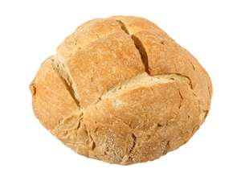
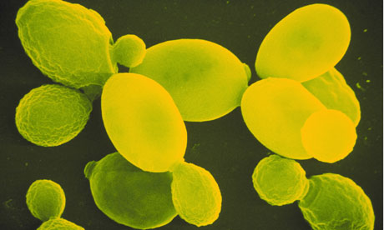
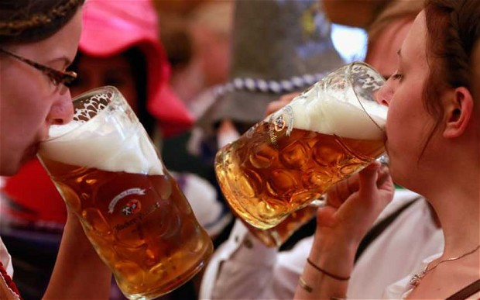
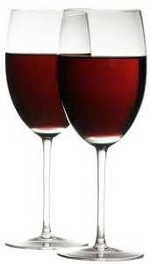
Anaerobic Respiration
1. In yeast and plants
glucose → ethanol + carbon dioxide (+ energy)
C₆H₁₂O₆ → 2C₂H₅OH + 2CO₂ (2 ATP)

Slide 30
Anaerobic Respiration
Both products of fermentation can be used commercially:
1) Ethanol – is useful in the production of beer and wine.
2) Carbon dioxide – is used in bread making.
Dough: flour + water

Slide 31
Anaerobic Respiration
2. In muscle during hard (vigorous/ strenuous) exercise – when oxygen is in short supply, muscle cells can respire for a short time, producing a small amount of energy.
glucose → lactic acid + energy
C₆H₁₂O₆ → 2C₃H₆O₃

Slide 32
Anaerobic Respiration
Q: What will happen to the lactic acid in muscle?
Lactic acid is toxic, so has to be removed from the body.
It is broken down by combining with O₂ in aerobic respiration in the liver to form carbon dioxide.
Q: Why do you continue to breathe fast and deep and has a fast heartbeat after exercise?
O₂ is used to break down lactic acid.
The amount of oxygen needed to break down lactic acid is called the oxygen debt.

Slide 33
Anaerobic Respiration
After exercise, there is a fast heart rate to transport lactic acid in the blood from the muscles to the liver.
Also, there is deep breathing to supply more oxygen for the aerobic respiration of lactic acid.

Slide 34
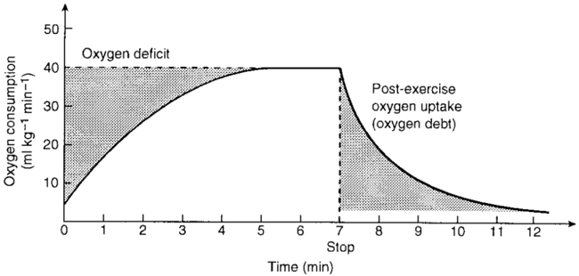
Anaerobic Respiration

Slide 35
Respirometer
A respirometer is a device used to measure the rate of respiration of a living organism.
You can use small, active invertebrates or germinating seeds.
Usually designed to measure oxygen uptake while CO₂ is absorbed.
manometer

Slide 37
